Slide 1
Bimboism as Counter-Culture
Gabriella Mendez
Radical Histories
December 8th, 2021

Slide 2
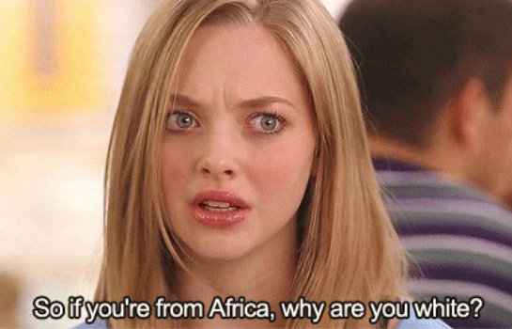
What is a bimbo?
1. dated slang, usually disparaging : MAN, FELLOW
2. informal + usually disparaging : WOMAN
especially : an attractive but stupid woman
Notes:
Merriam-Webster includes two definitions of bimbo
The word is derived from the Italian word for baby, and initially referred to a foolish man. Over time though, it became an insult exclusively used against women.

Slide 3
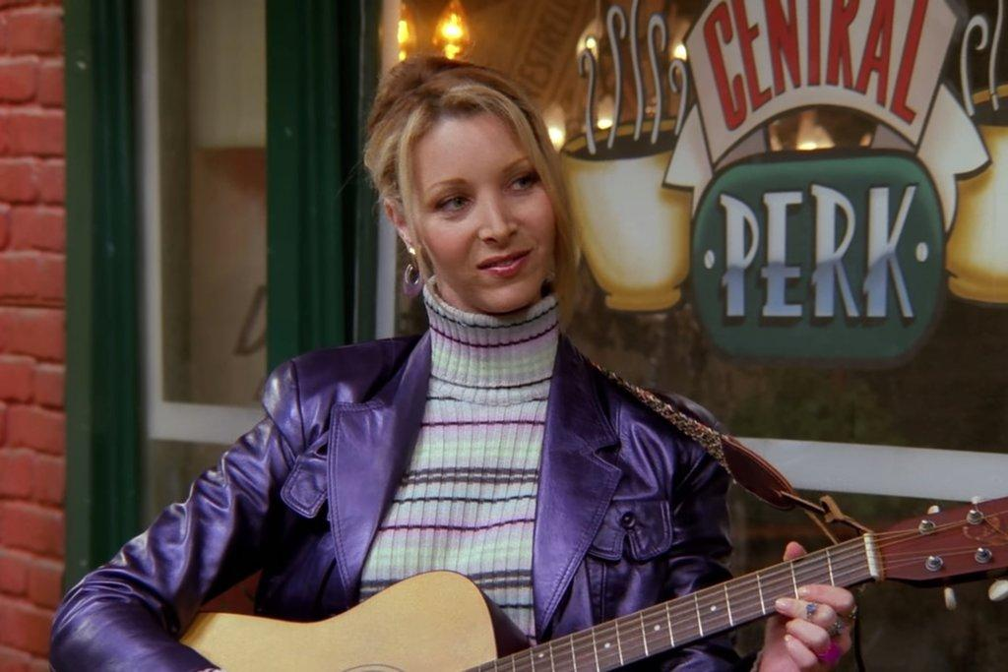
Dumb Blonde
Notes:
She is more than the dumb blonde, who is marked more by her naivete or cluelessness

Slide 4
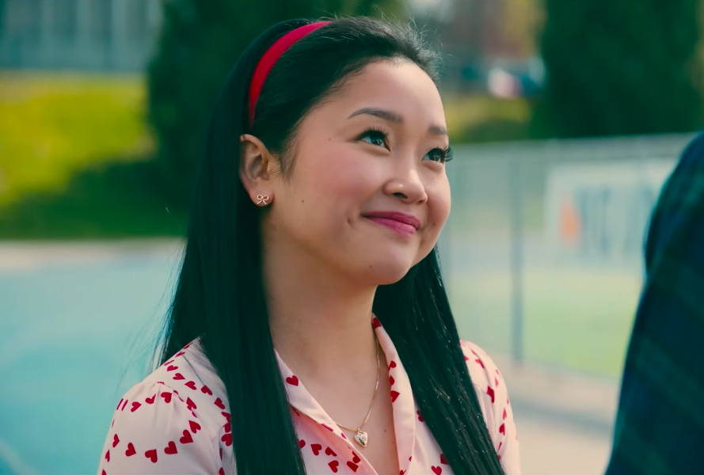
Girly-Girl
Notes:
She is more than the girly-girl, who enjoys her hyperfemininity and puts effort into her appearance

Slide 5
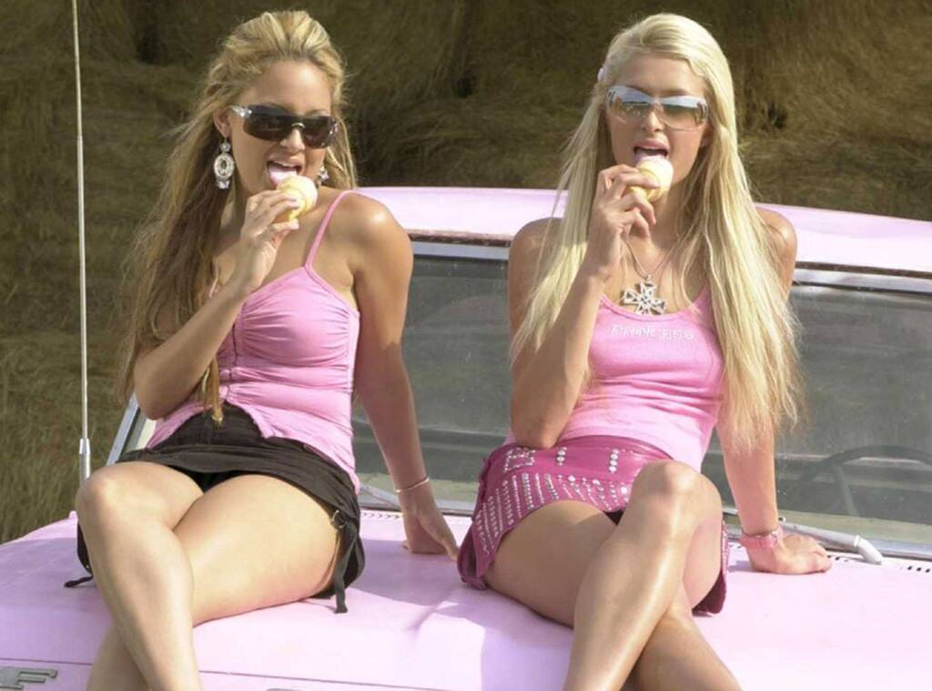
Bimbo
Notes:
The bimbo is identified as the overlap of the previous, but distinguished by her increased sexuality.
In film and TV, the bimbo

Slide 6
Bimbos as a Cultural Product

Slide 7
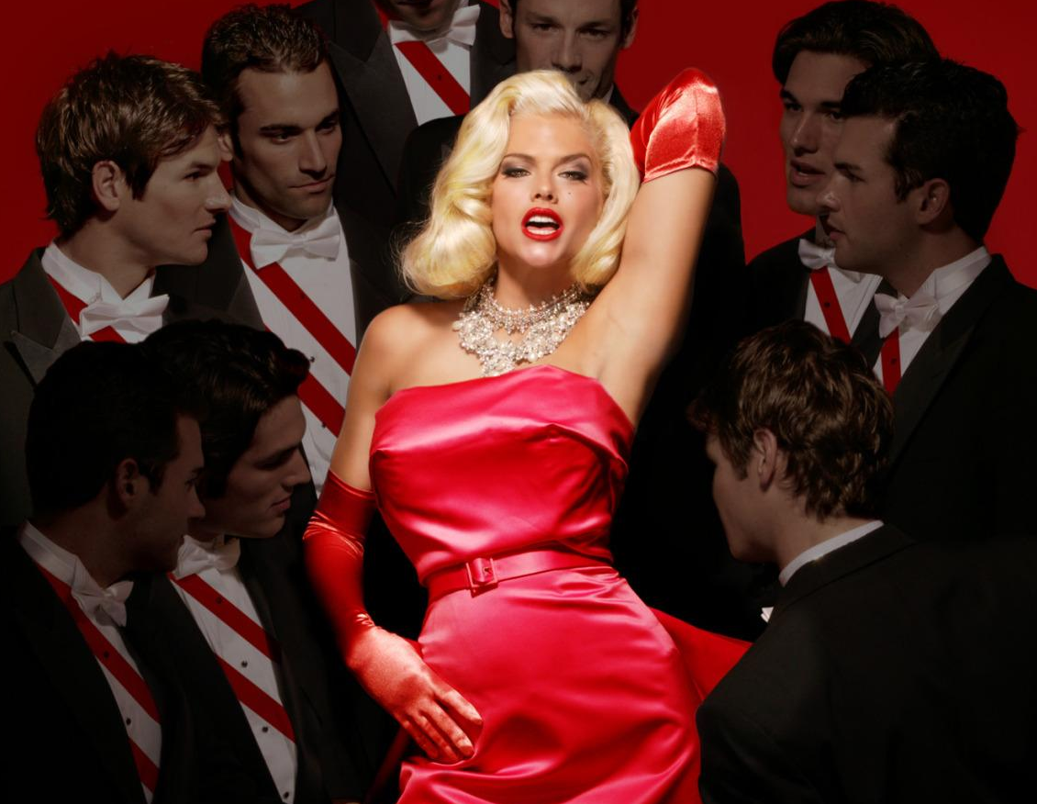
Selling the Bimbo Trope
As a woman and a product for entertainment, the bimbo archetype is offered no humanity by viewers.
Notes:
They are a caricature of a caricature, and are objectified as both a woman and a commodity
The IDEA of the bimbo is a product; the establishment of the archetype creates a normalized product for media to sell
In media, then, the actress is alienated from her own work and her image as the bimbo becomes the product rather than her talent
This image is a perfect example of the postmodern crisis in representation - Anna Nicole Smith (already established as a bimbo by the media) represents Marilyn Monroe (depicted at times as a bimbo in her era)

Slide 8
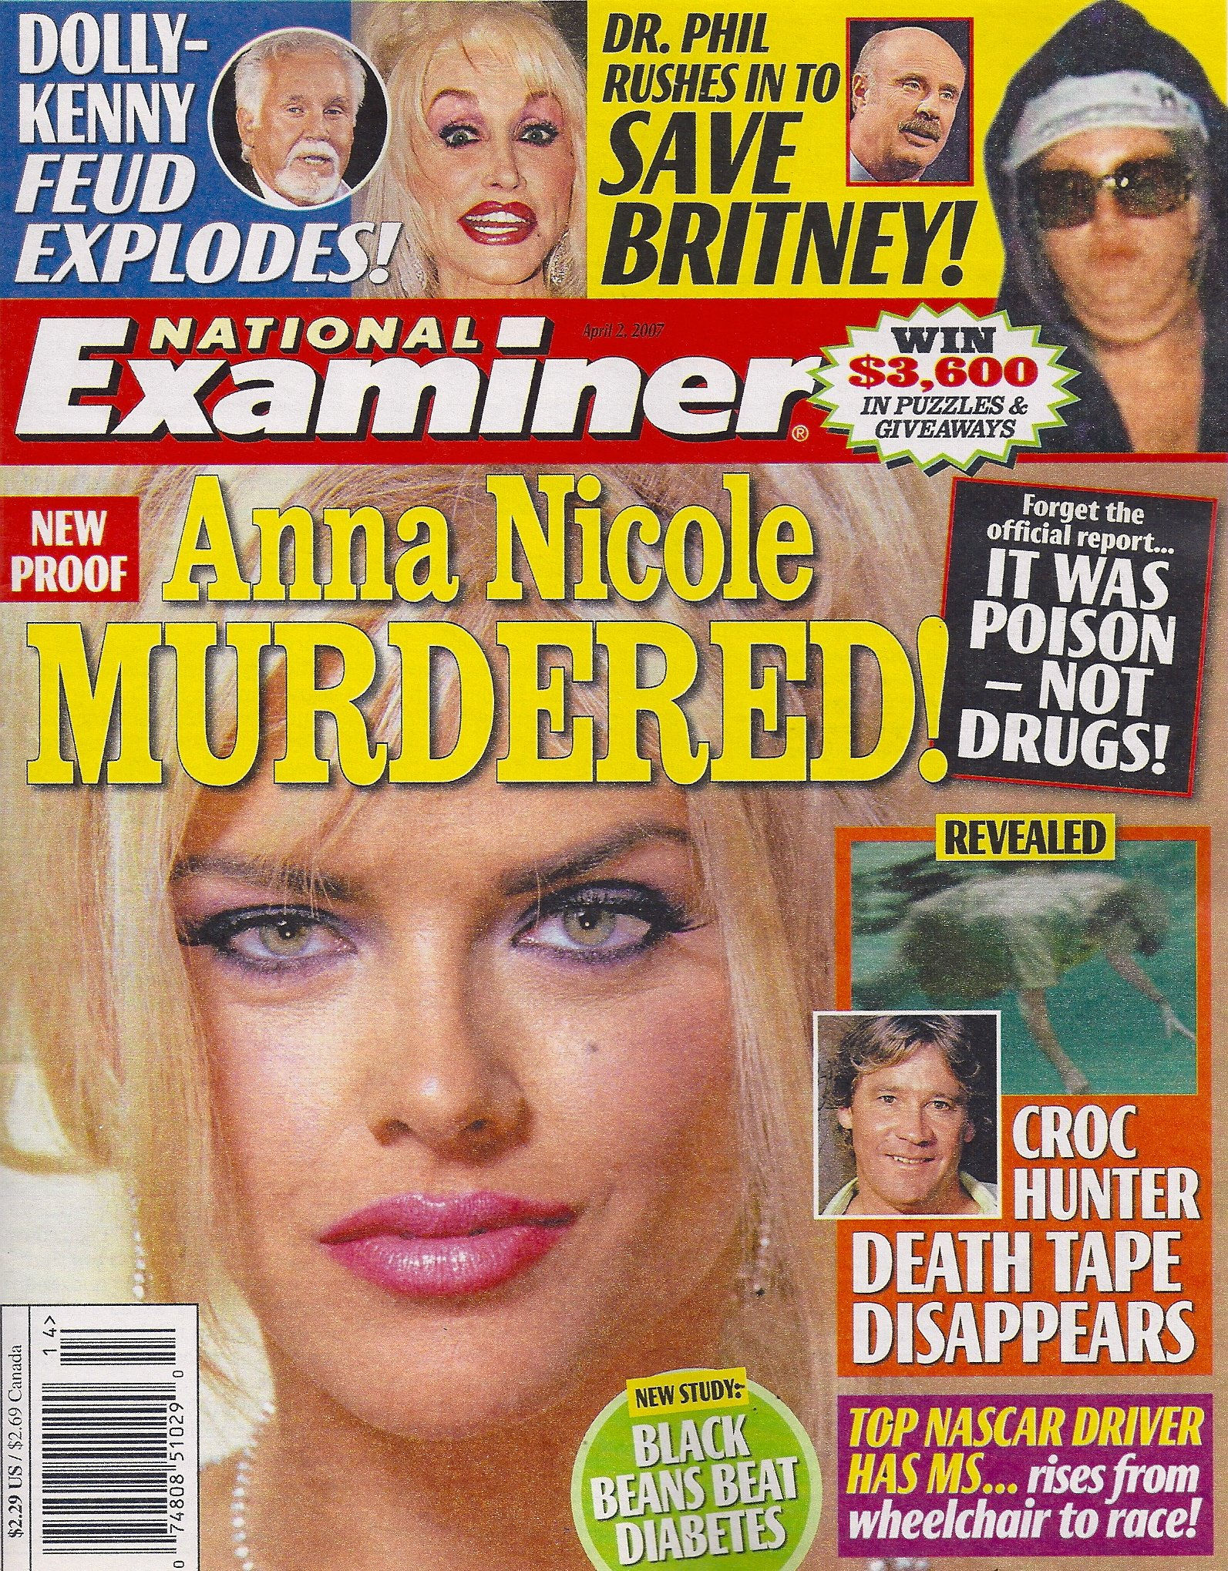
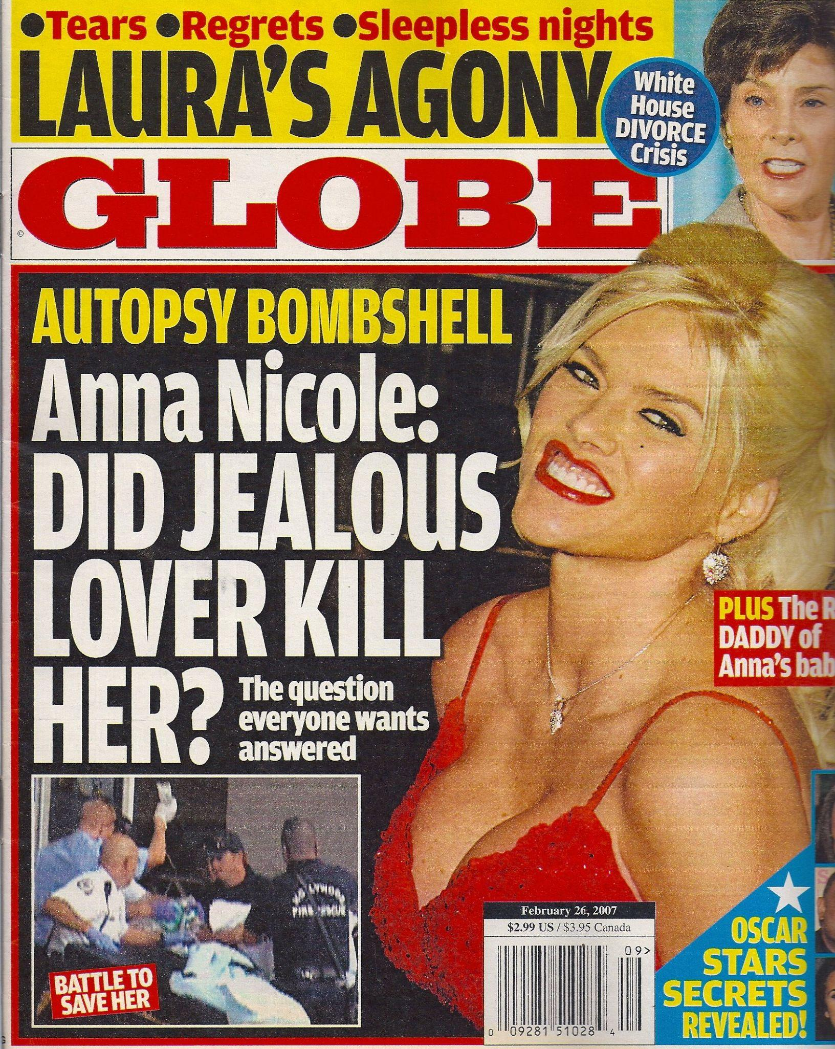
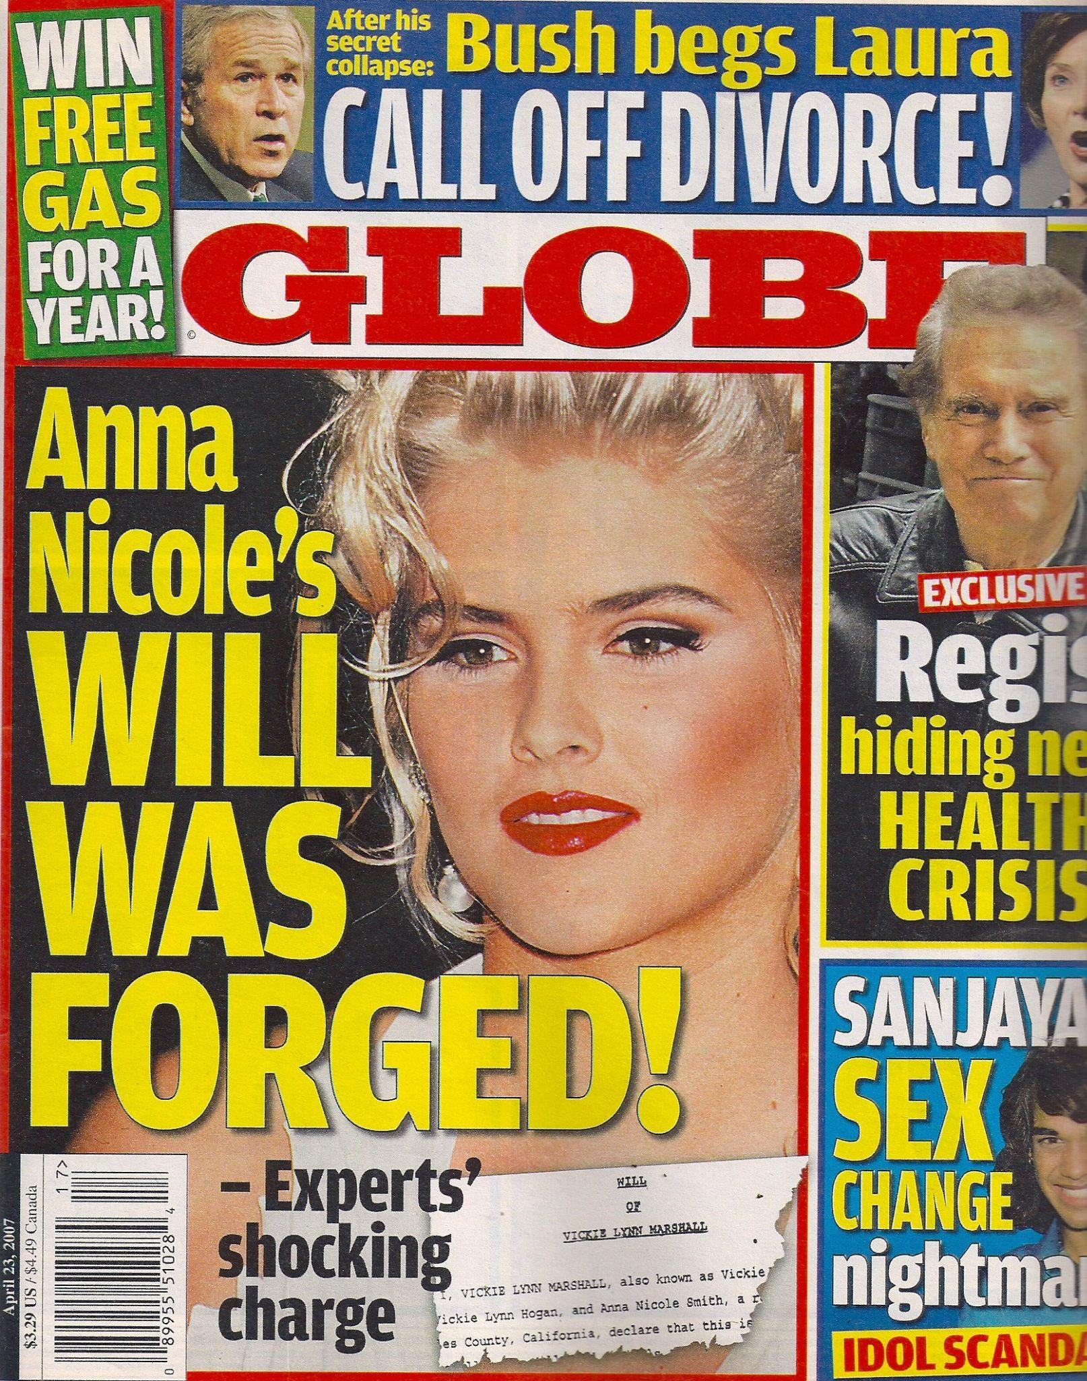
Notes:
Anna Nicole Smith exemplifies the commodification of the bimbo
her depiction in media was conflated with her actual persona
her entire life was a media gold mine. Her life, death, and all scandals were milked for tabloids
mirrors Wark’s assertions on intellectual property/ideas themselves as “as tradable as pink goo”

Slide 9
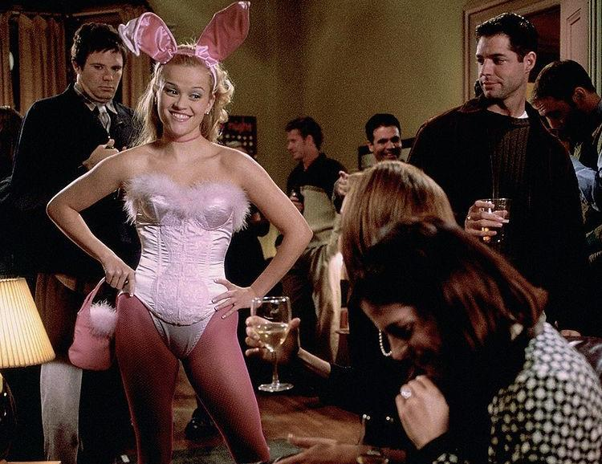
Real World Effects
The fantasy of the bimbo allows for the unusual overlap of disdain from both feminists and chauvinists.
Notes:
In seeing her as an object rather than a person, the bimbo becomes a victim of the Madonna-whore complex.
Coined by Freud, the Madonna-Whore complex describes the tendency of heterosexual men to see women exclusively as the Madonna (virginal/pure and thus capable of being loved) or as the whore (sexually comfortable and thus tainted)
Despite the fact that the bimbo is a fantasy -- a pure caricature -- the trope still perpetuates ideas of female standards and desirability

Slide 10
Reclaiming
the Term

Slide 11
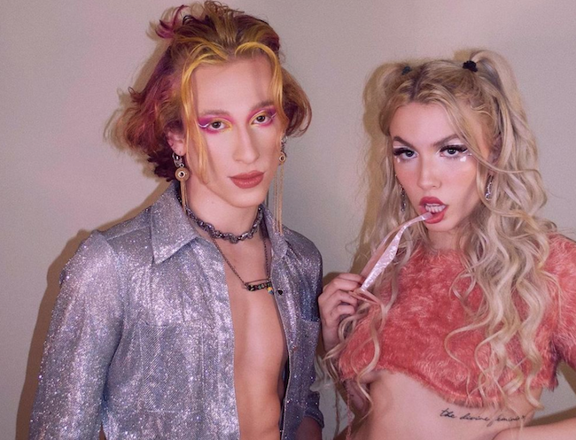
New Age Bimboism
In using “bimbo” as a self-descriptor, the insult is given new meaning.
Once used broadly to refer to stupidity, New Age Bimboism frames the term as a rejection of elitism.
Notes:
In prioritizing compassion, fun, and visual appearance, the New Age Bimbo rejects the capitalist concern for marketability; all focus is on the individual’s pleasure.

Slide 12
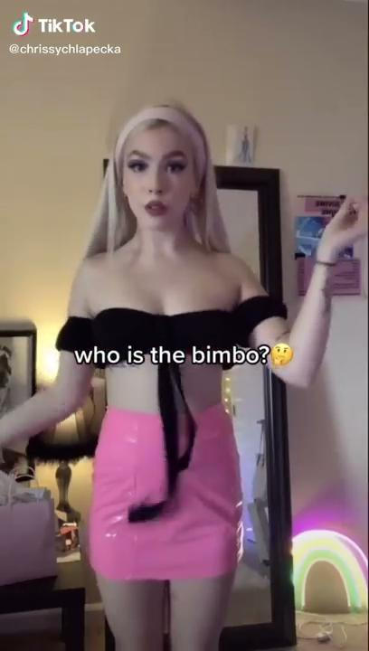
Notes:
Chrissy Chlapecka has become a beacon for New Age Bimboism on TikTok – here is a short clip of her personal definition of a bimbo.

Slide 13
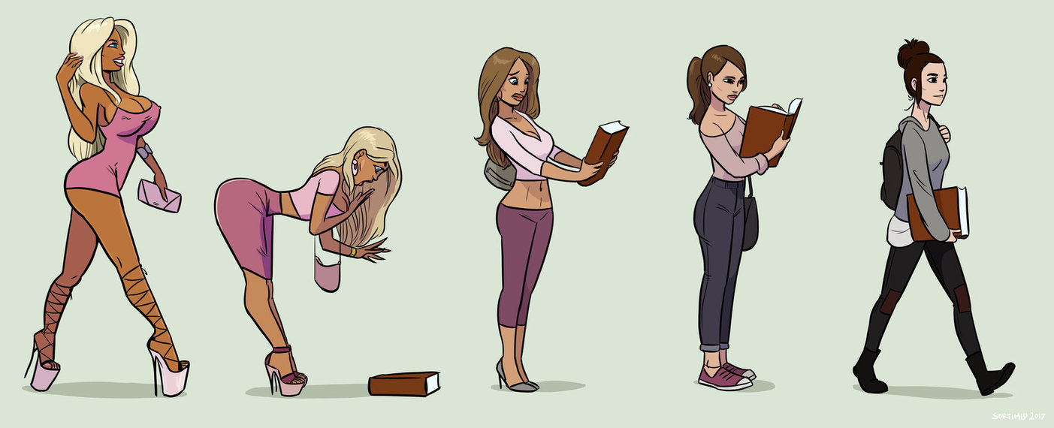
Subversion of (De)Bimbofication
Notes:
Making its way into niche fetish communities, de-bimbofication rose as a manifestation of the Madonna-whore complex, in which the process of educating the bimbo was sexualized
While this may seem like a tangent, I bring up this image as a crucial aspect of the counter-culture of New Age Bimboism
Once the idea of de-bimbofication (and this image in particular) made its way to the mainstream, it was granted new meaning by the masses.

Slide 14
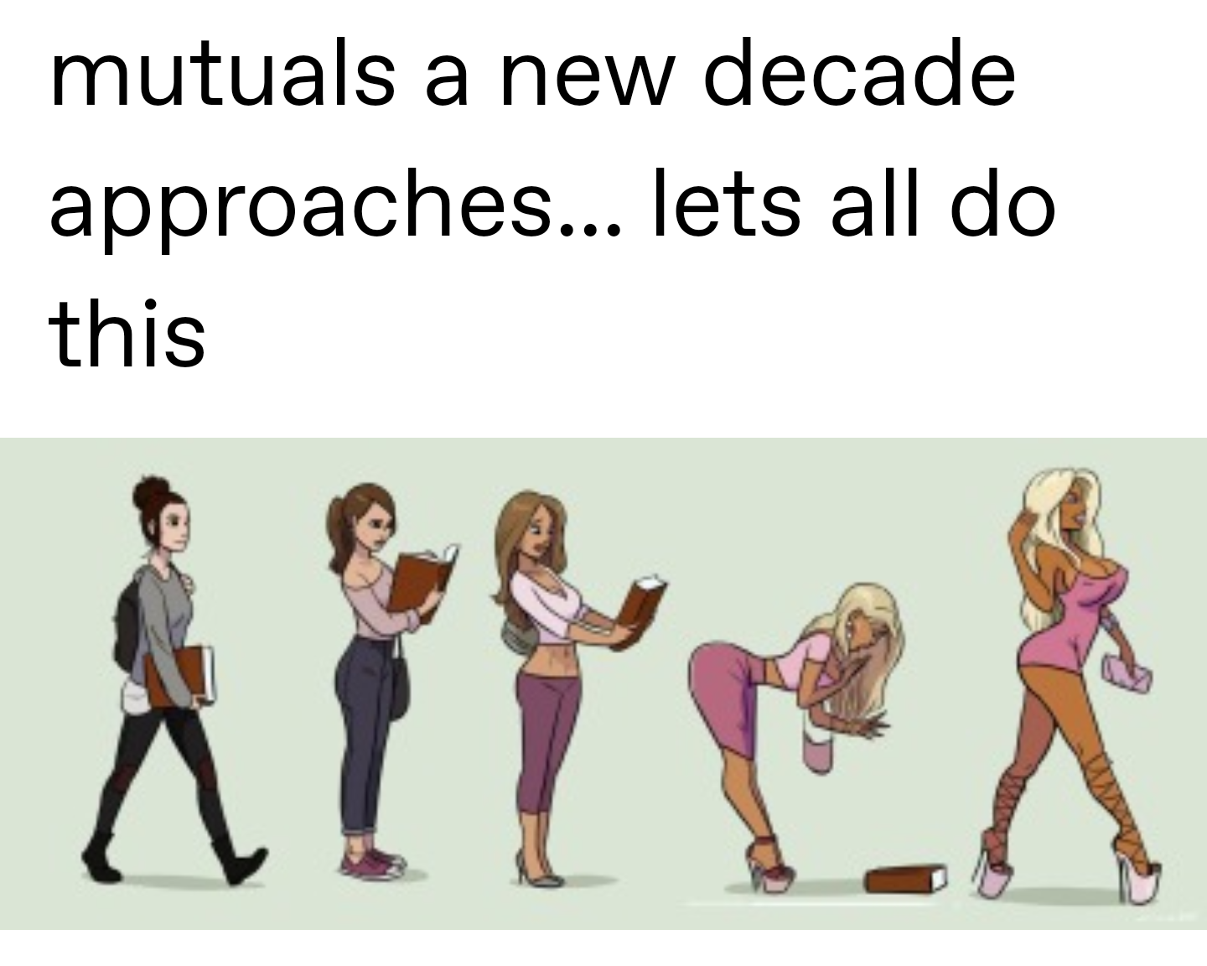
Notes:
In the image’s dissemination, bimboism and bimbofication grew in popularity
the bimbo trope emerged as just as worthy of humanity as the cool girl or tomboy trope.

Slide 15
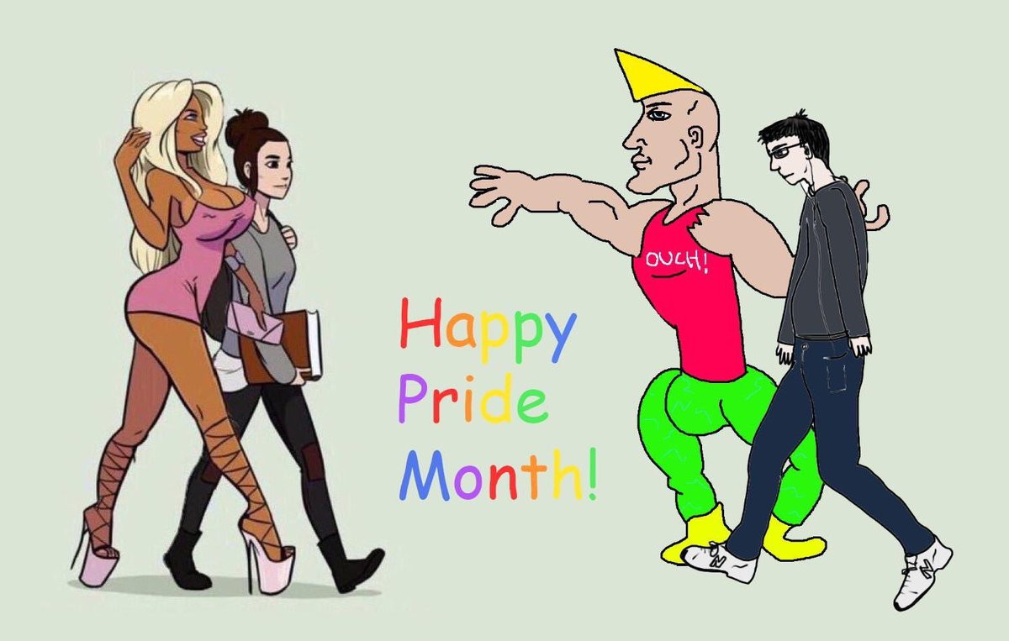
Notes:
In the creation of memes, the meaning of the image and its original connotation is forever changed
This image depicts the opposites of the spectrum in the bimbofication image on the right, as well as two key images of the incel movement, the Chad and the Virgin.
As Hebdige asserts, the appropriation of objects is key in resistance.

Slide 16
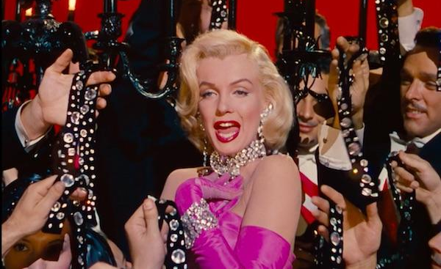
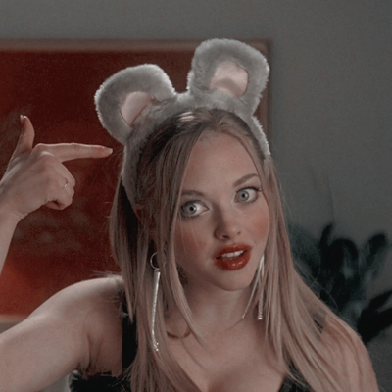
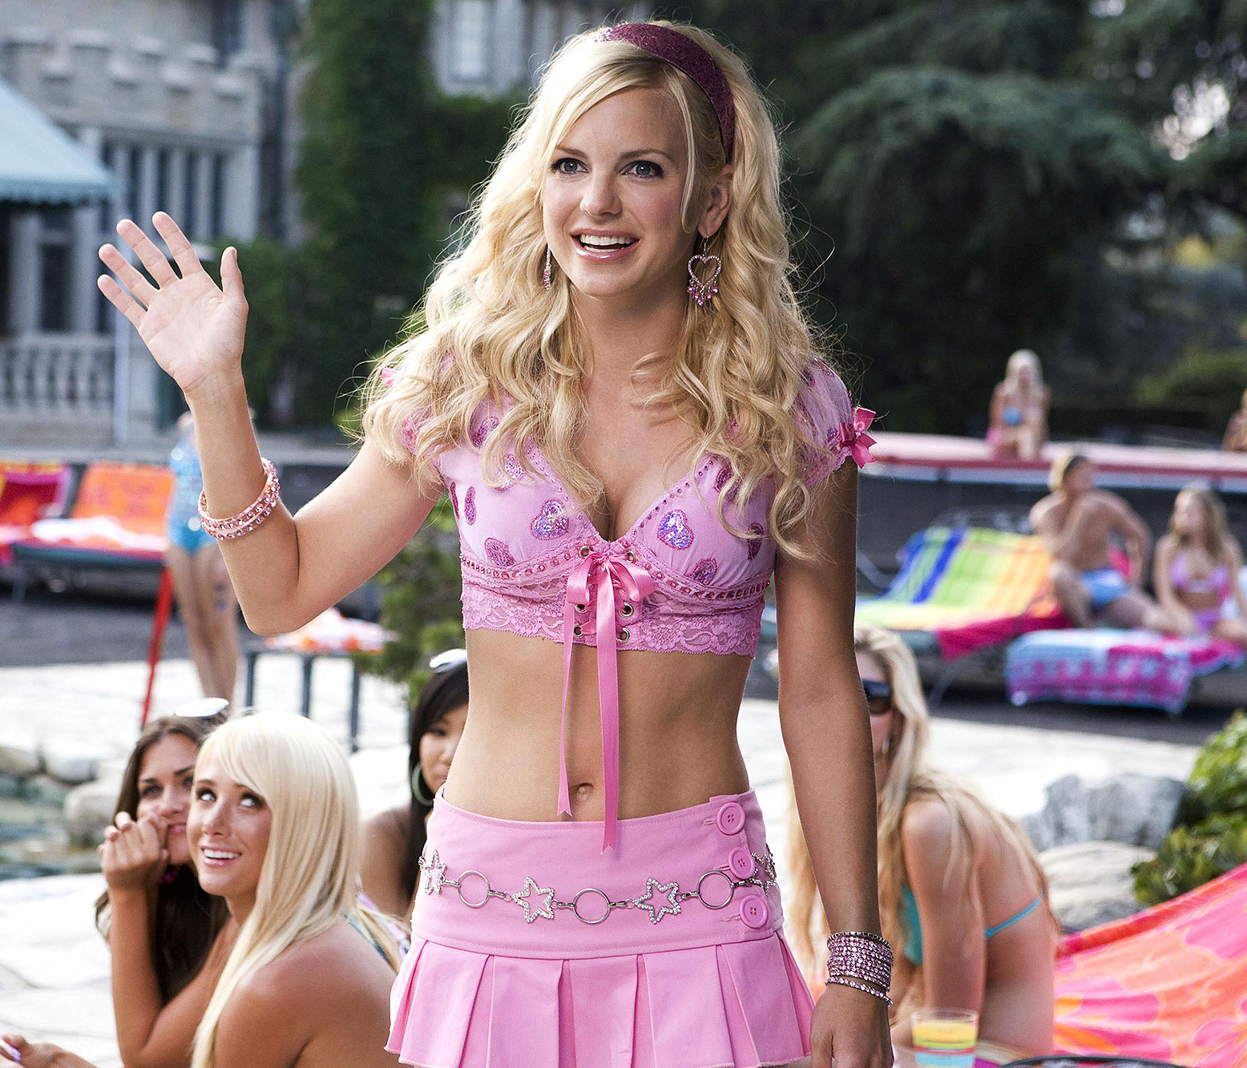
Notes:
Despite preconceived notions of the bimbo trope, the word is being reclaimed by people everywhere
The sellable traits of the bimbo caricature have done damage in regards to gender norms, but in subverting the term we are capable of changing its connotation

Slide 17
Sources
“The Bimbo Trope, Explained - Reclaiming the Label.” YouTube, The Take, 10 Feb. 2021, https://www.youtube.com/watch?v=r2eoegcgBdw.
Cortés, Michelle Santiago. “Our Smooth Brained Future: The Rise Of The New Age Bimbo.” New Age Bimbos and Bimbofication TikTok Trend, 8 Dec. 2020, https://www.refinery29.com/en-us/2020/12/10204376/tiktok-bimbo-gen-z-trend.
Kearns, Sarah. “TikTok's Chrissy Chlapecka Is Redefining the Bimbo for Gen-Z.” Lithium Magazine, 27 Apr. 2021, https://lithiumagazine.com/2021/04/27/tiktoks-chrissy-chlapecka-is-redefining-the-bimbo-for-gen-z/.
Tang, Chelsea. “The Word 'Bimbo' Is Getting a Rebrand.” Elle Singapore, 22 Feb. 2021, https://www.elle.com.sg/2021/02/22/the-word-bimbo-is-getting-a-rebrand/.

